Slide 1
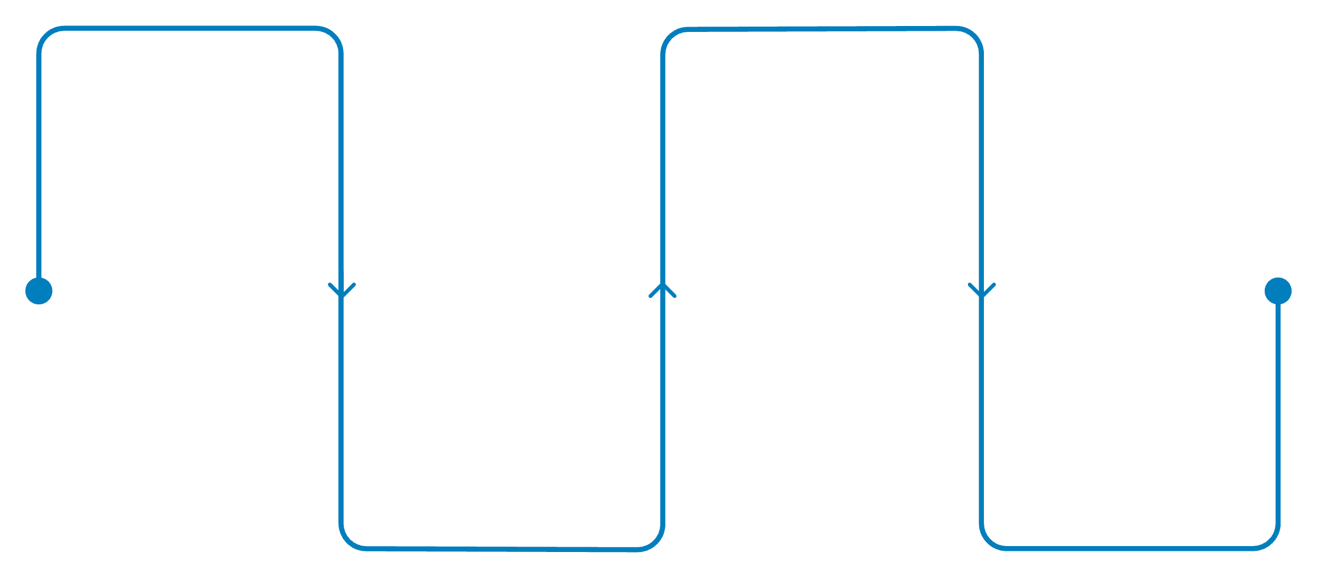
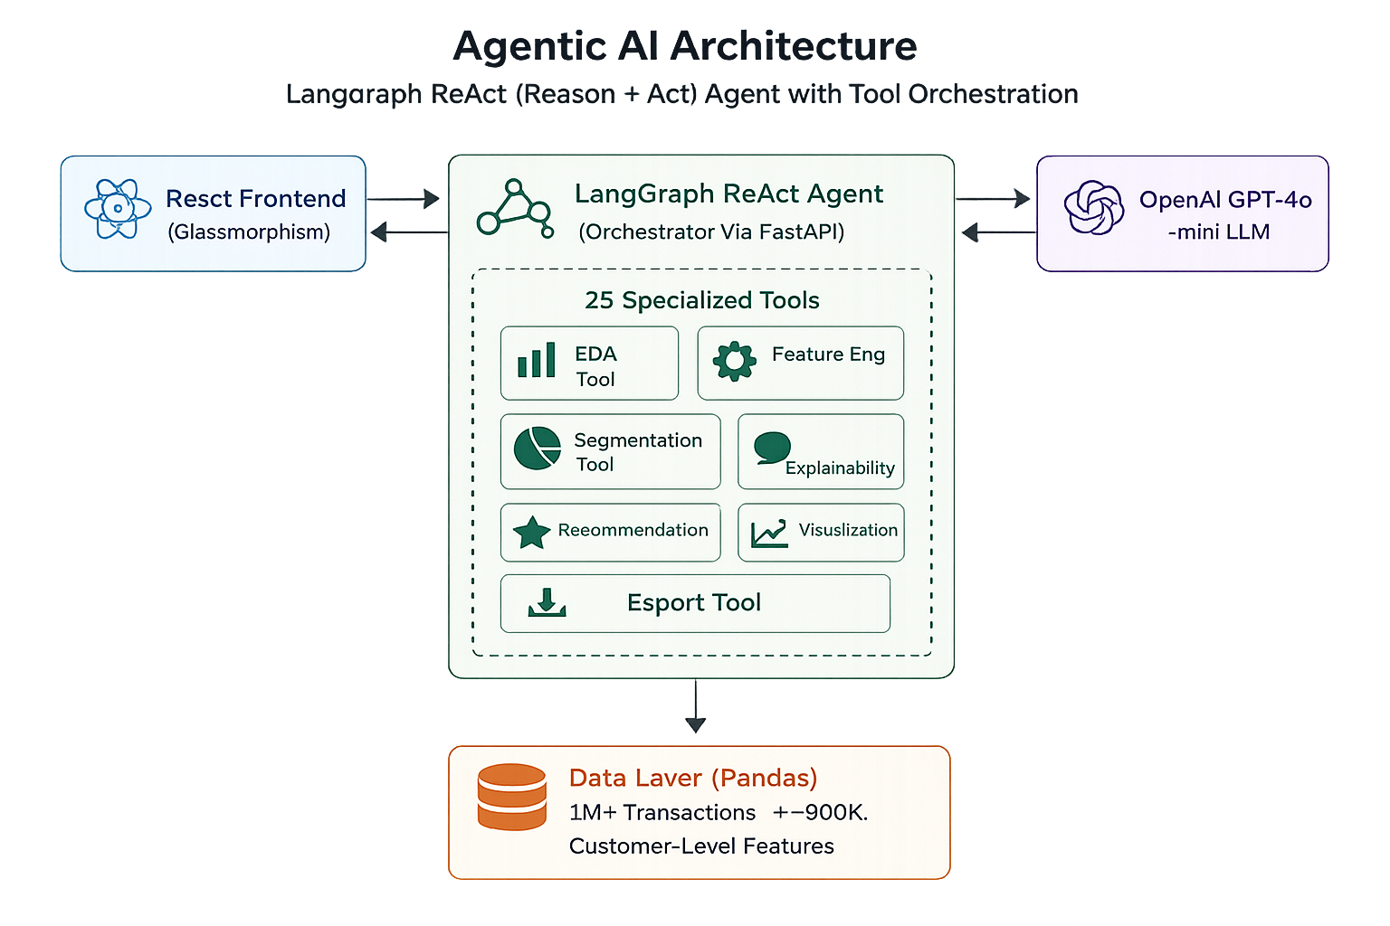
Team: Kurkure
Team Member: Adithya Sankar Menon
Customer Segmentation & Personalization Agent for Retail Banking
Autonomous AI agent replacing one-size-fits-all banking marketing — analyzing 1M+ transactions, segmenting customers, and recommending personalized products via natural language.
User Query
Tool Chain
Submit NL query in chat
Dynamic chain of 25 specialized tools
Recommendations
Orchestrator
Personalized products with explainability
ReAct parses intent, selects tools
LangGraph dynamically chains a subset of 25 specialized tools — EDA, Feature Engineering, Segmentation, Explainability, Recommendation, Visualization — into a multi-step pipeline executed fully autonomously.
React + Vite
FastAPI
Glassmorphism UI
Async backend
LangGraph
GPT-4o-mini
ReAct orchestration
LLM reasoning
GitHub Repo Link: https://github.com/AdithyaSM31/retail-bank-segmentation-agent
Video Demo Link: https://drive.google.com/file/d/1SuNwCxlzHUvPdeqxf7eHyDWiXkeIIC5p/view?usp=sharing

Slide 2
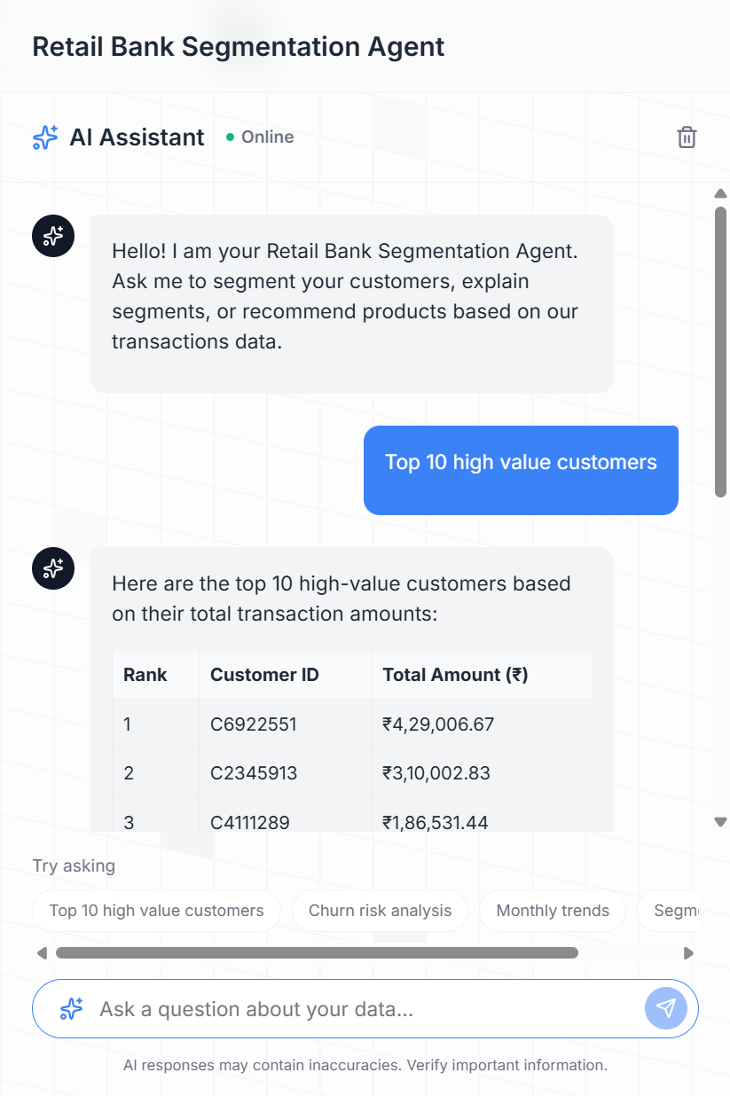
What Makes This Stand Out
True Agentic Autonomy
Executes deterministic multi-step pipelines — Engineer Features → ML Clustering → Plot Distributions — fully autonomously based on query context.
Dual-Method Segmentation
Business Rules (Priority/Dormant/Regular) + MiniBatchKMeans with automatic Silhouette Score optimization.
Explainability Engine
AI explains exactly why each customer was assigned to a segment — feature thresholds, contribution scores, and decision boundaries.
Premium Glassmorphism UX
GPU-optimized animated dashboard with interactive Plotly charts — analytics teams actually enjoy using it.

